Slide 1
Distribution Impact: Customer and the Utility
By Steve Hinkel
May 2010
Columbus, OH

Slide 2
Agenda
Level set existing distribution network
“Future” distribution network
Customer experience
Q/A

Slide 3
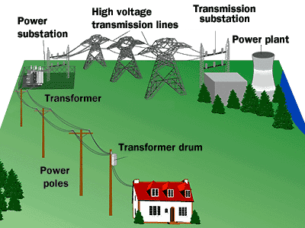
Level set existing distribution network
What is the distribution network?
How smart is the current version?

Slide 4

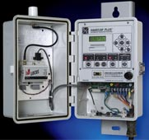


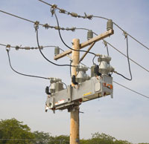
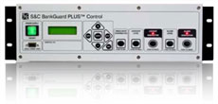
“Future” Distribution Network
Plethora sensors
Intelligent equipment
Renewable integration
Health monitoring
Self Healing equipment

Slide 5
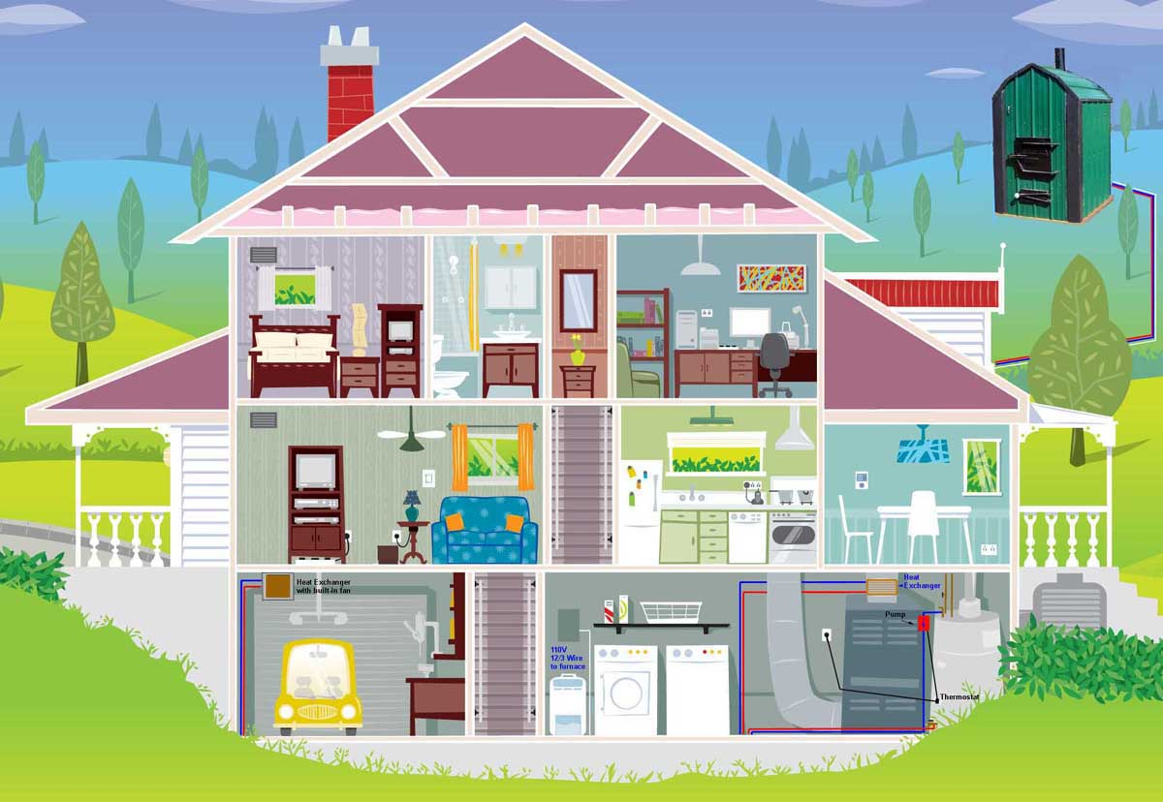
Customer Experience
Renewable Integration
Master Controller
Occupancy Sensors
Storage
Vampire Loads
Vehicle Electrification
Appliances
HVAC Integration

Slide 6
Appendix

Slide 7
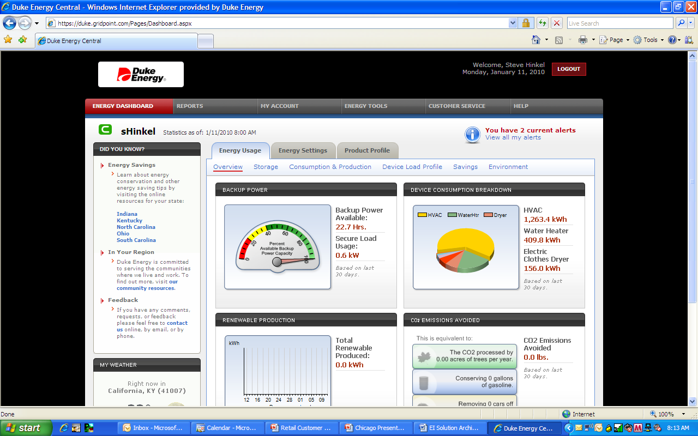
Transparency - Real Example

Slide 8
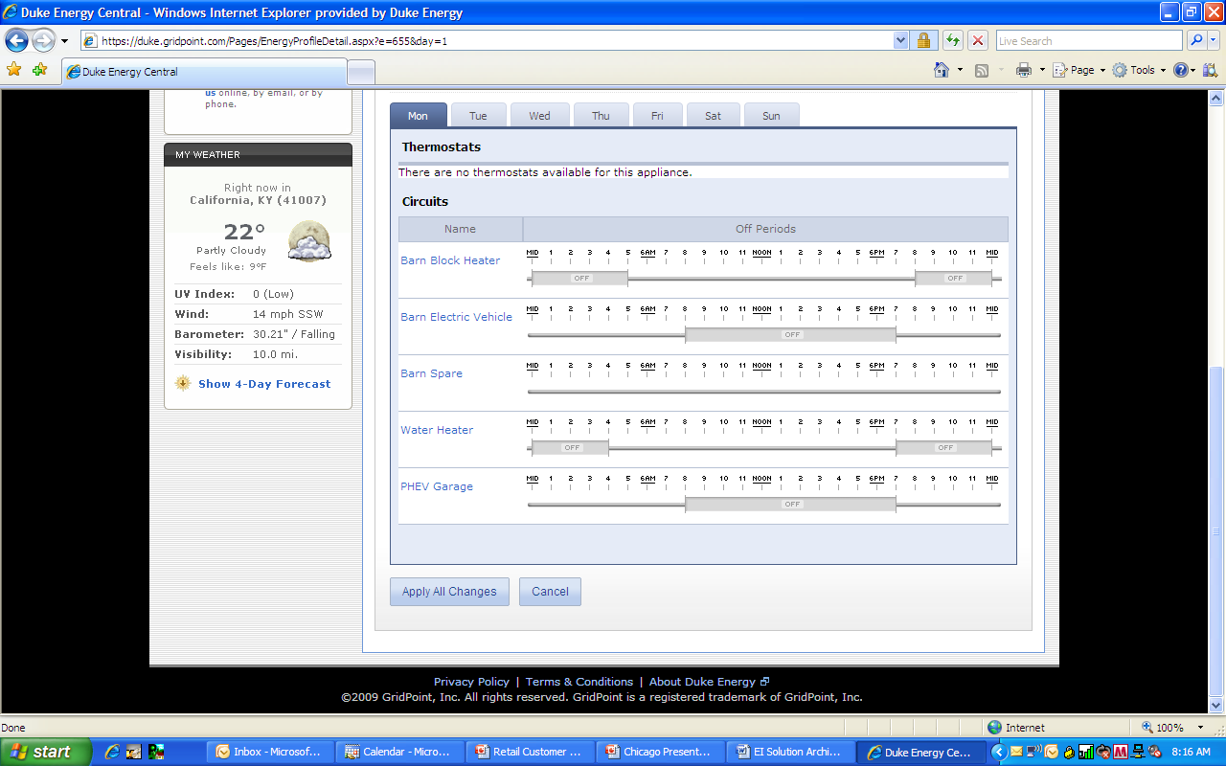
Control – Real Example

Slide 9
Net Result – huh?

Slide 10

Hurdles
“Technology Treadmill”
Consumer Perceptions
  Energy management is foreign
  “Big Brother”
Regulatory Landscape
  Utility compensation model = Save a Watt
  NIBY
  Menu of options
  Simpler bill/cost structure

